Slide 1
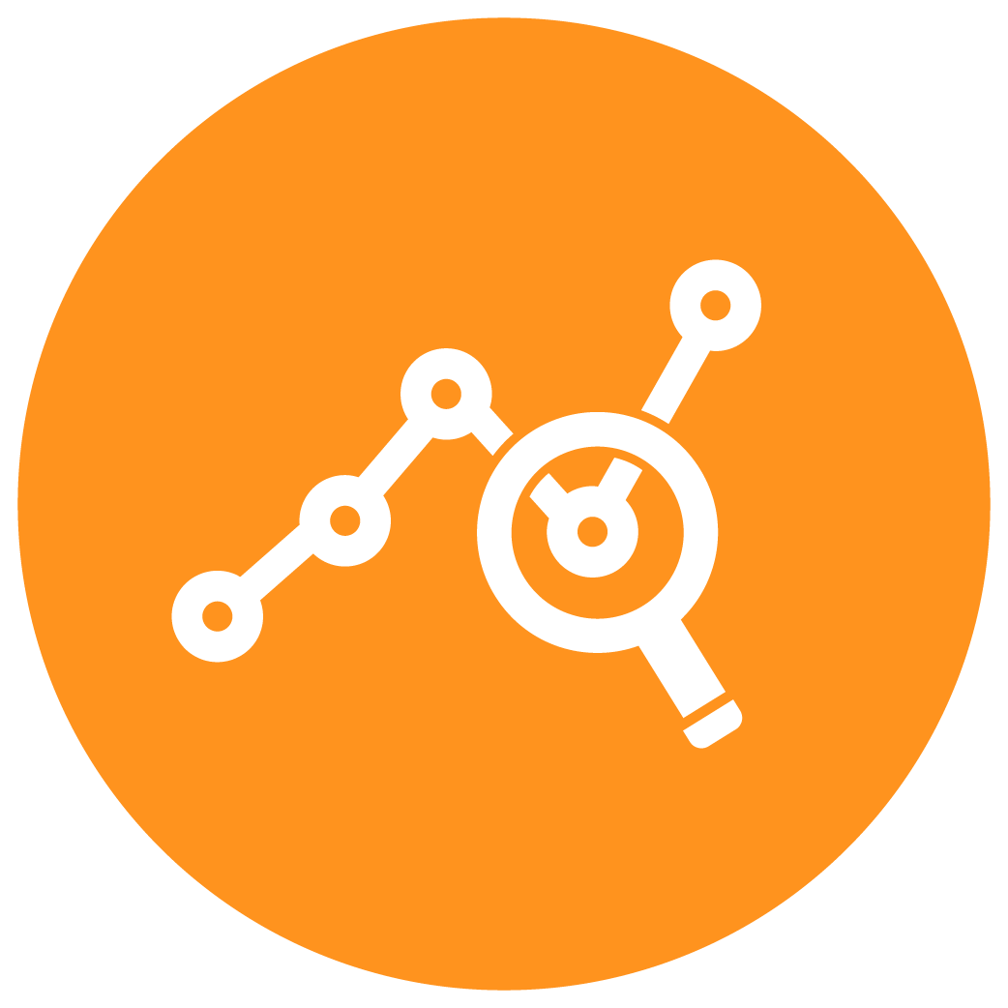
Data Visualization. Exploratory Data Analysis
Seeing what's inside our data… and allowing others to see
Yordan Darakchiev
Technical Trainer
iordan93@gmail.com

Slide 2
sli.do #DataScience

Slide 3
Table of Contents
Main concepts and rules
Creating simple plots
Real-life examples: good and bad
Customizing plots
Exploratory data analysis
Basic guidelines
EDA as part of the data science process

Slide 4
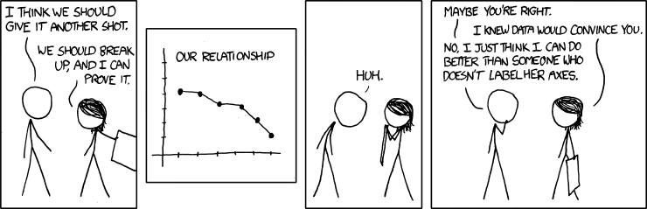
Be Careful…

Slide 5
Main Concepts in Data Visualization
How to tell the right story

Slide 6
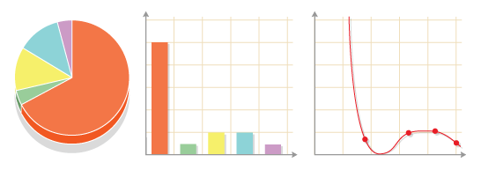
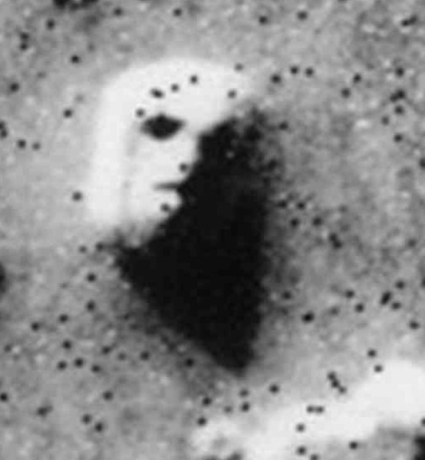
Data Visualization
We're amazingly good at spotting patterns
Trends over time, correlations, comparisons, ranges, etc.
Visualizing data helps us understand the information better
By plotting different views on the data we can
Help ourselves explore and understand the data
Convey the stories in data to others
Note that we're too good at spotting patterns
We can find patterns where they don't exist

Slide 7
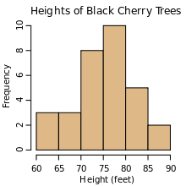
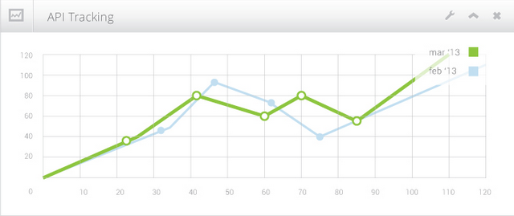
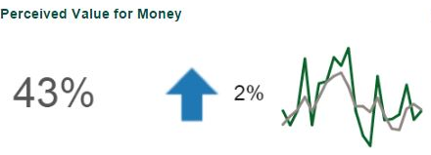
Knowing What (and When) to Plot
Many types of graphs, each with its own purpose
Histograms – show distributions
Boxplots – show the range and skewness of values
Bar charts – show how different categories compare
Line plots – show how one (dependent) variable varies with respect to an independent variable (e.g. over time)
Pie charts :( – show relative sizes between parts of a whole
Don't forget that we can also display single numbers when they provide sufficient information

Slide 8
Knowing What (and When) to Plot (2)
Many more types of graphics depending on the context
Choosing the right plot is a matter of intuition
The goal is to present the message clearly
I.e. "tell the right story"
Two main kinds of visualizations
For scientific analysis and work – stricter rules
For exploratory analysis / quick references
For presenting results to non-specialists – we can be creative but we have to keep our message in mind
The results may be printed or viewed as a dashboard
How many dimensions?
Each plot has two spatial dimensions but we can add more using color, size, even animation

Slide 9
Knowing What (and When) to Plot (3)
To choose a plot type, think about
Numerical or categorical variables
Structure – spatial, temporal, etc.
Clustering
Relative size
How can you know what all of these are?
Perform an exploratory data analysis first
"Play around" with the data
Check different measures (such as means, standard deviations, ranges, etc.), plot different charts
Explore the distributions and relations of variables
Document the exploration process and your findings to remember them later

Slide 10
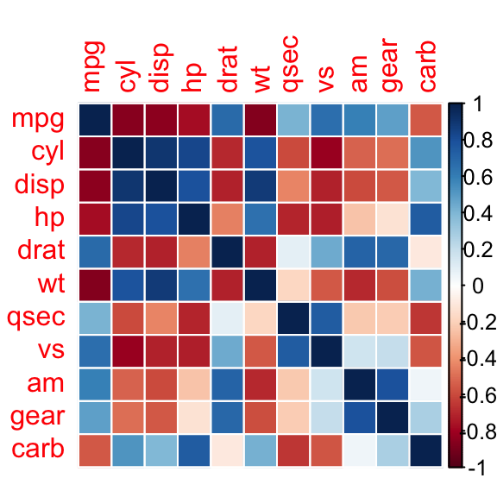
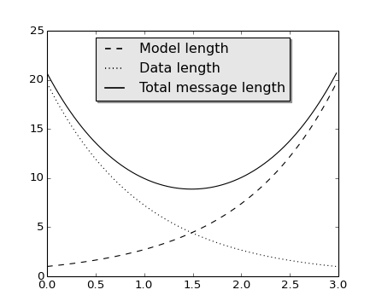
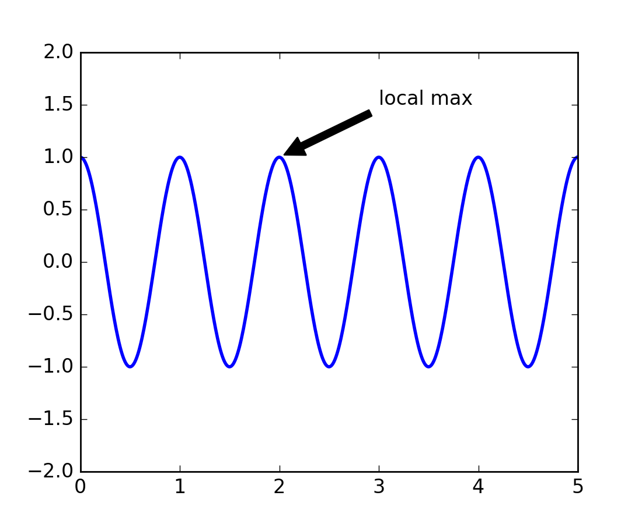
Basic Rules
Choose the appropriate chart type
If you can (and want), compare different types of charts
Make your plot big enough to fit the plotting area
When it's not obvious, add a title and a legend
Label the axes!
Optionally, point at interesting data
Use marker size and color to convey information
Don't strain the reader!

Slide 11
Plotting Basics
Starting out easy

Slide 12
Plotting in matplotlib
Quite easy to start plotting
Very powerful
There are many ways to do the same thing
The documentation and examples are really good
We’ll often end up consulting them, or the community
There are many options and it’s difficult to remember them all
Importing the library
In Jupyter notebook, write the magic string %matplotlib inline in the first cell before importing
This will make plots appear as images in the notebook
import matplotlib.pyplot as plt

Slide 13
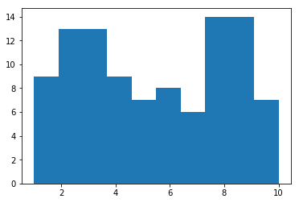
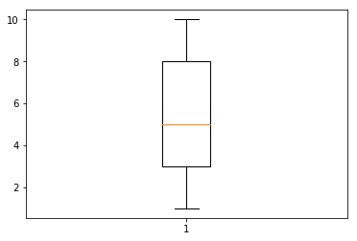
Creating Simple Plots
Histogram
Shows the distribution of one variable
Boxplot
Another way to show the distribution of one variable
May also be used to compare many distributions
How to read a boxplot
import numpy as np
values = np.random.randint(1, 11, 100)
plt.hist(values)
plt.show()
plt.boxplot(values)
plt.show()

Slide 14
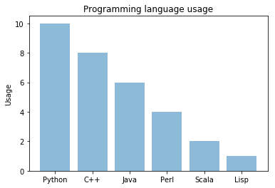
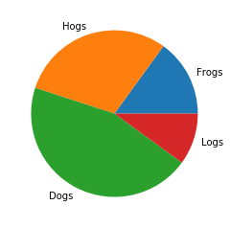
Creating Simple Plots (2)
Bar chart
Shows how one numeric value compares among different categories
Two variables: one categorical, one numerical
A little bit more difficult to plot
See a tutorial here
Although they look similar, histograms and bar charts are different!
Pie chart
Shows the relation of each part to the whole
sizes = [15, 30, 45, 10]
plt.pie(sizes, labels = ["Frogs",
"Hogs", "Dogs", "Logs"])
# Make the plot look circular
plt.gca().set_aspect("equal")

Slide 15
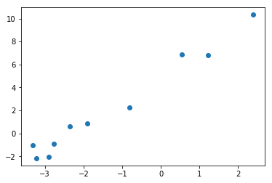
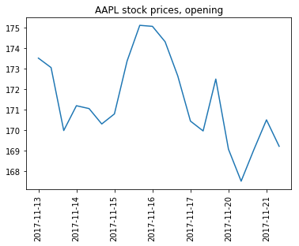
Creating Simple Plots (3)
Scatterplot (or scatter plot)
Shows how two variables compare
Can be used for displaying trends or correlations
Line chart
Similar to scatterplot
Useful to show dependencies of two variables
If the horizontal axis is time – evolution
x = [-2.35, 1.22, -3.32, 2.39, -2.77,
-3.21, 0.55, -0.81, -2.89, -1.9]
y = [0.58, 6.79, -1.01, 10.32, -0.9,
-2.16, 6.87, 2.22, -2.05, 0.86]
plt.scatter(x, y)
plt.show()
dates = ...
open_prices = ...
plt.plot(dates, open_prices)
plt.xticks(dates[::3], rotation = "vertical")
plt.title("AAPL stock prices, opening")
plt.show()

Slide 16
Data Visualization Examples
The good, the bad, the ugly and the WTF

Slide 17
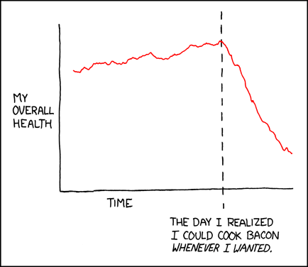
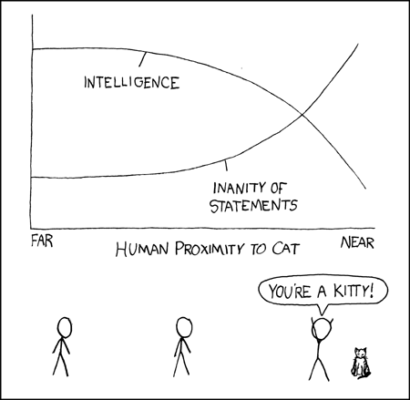
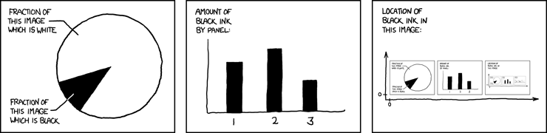
Some Examples

Slide 18
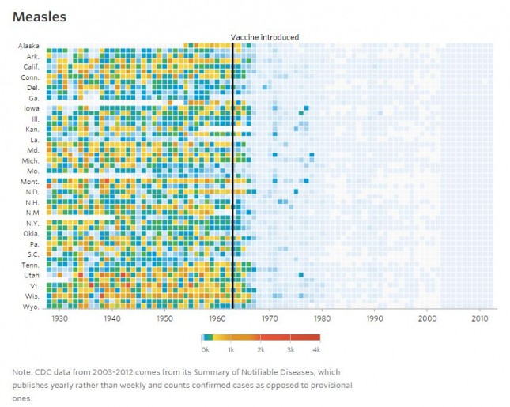
Infectious Diseases and Vaccines ✔
Once again, a heatmap is used to convey disease spread
The legend has numbers
The full chart is interactive (provides all numbers)
Makes use of temporal data
Labels an interesting point
Allows us to compare "before" / "after"
Conveys a clear message
Vaccines almost eradicated diseases

Slide 19
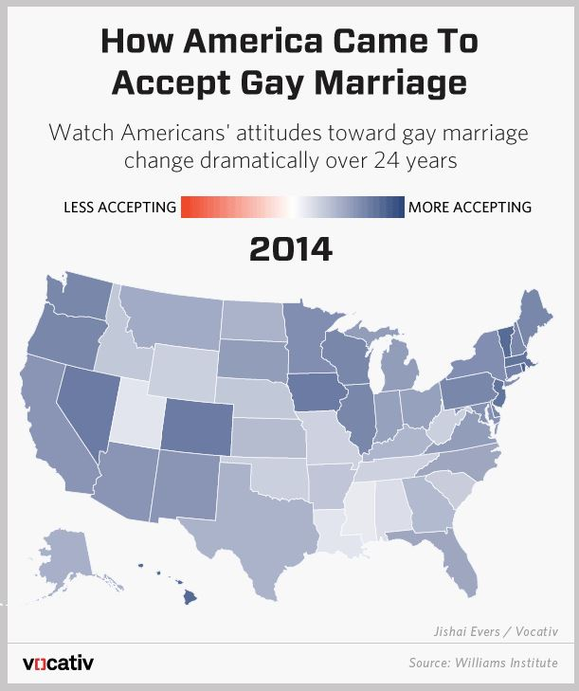
Gay Marriage Acceptance ✔
Good use of spatial structure (heatmaps)
Overall message is clear
All states are in the "more" category
Some states are more accepting
May additionally display numbers on the scale or on the map to give a quantitative view
This is an editorial, not a scientific plot so it's acceptable

Slide 20
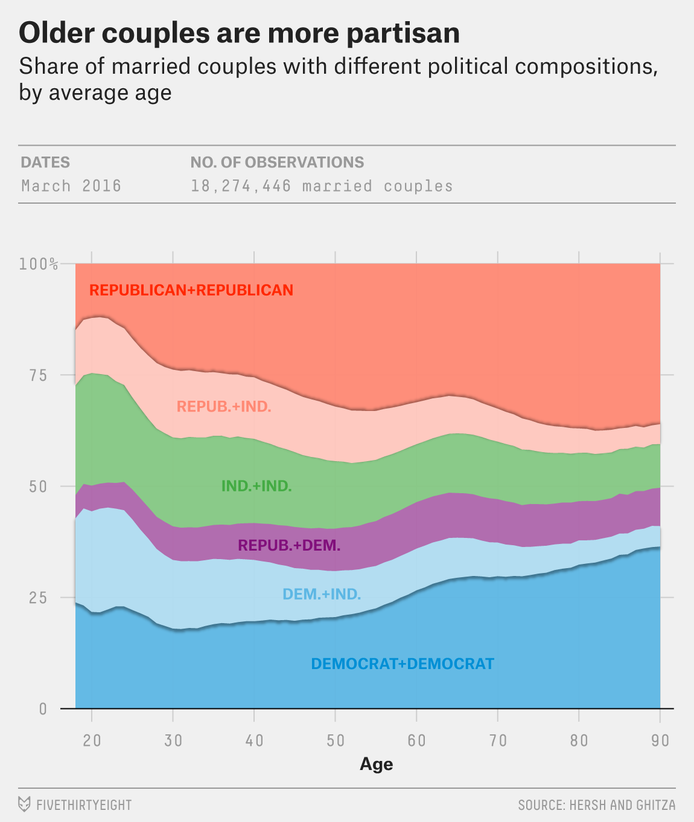
Political Views of Couples ✔
Source: FiveThirtyEight
Uses area plots to display relations
Allows comparison of different distributions for different ages
Uses a clear color map
Uses labels to make comparisons easier

Slide 21
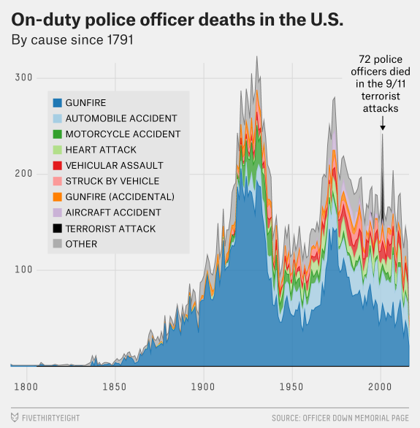
On-Duty Officer Deaths in the US ✔
Source: FiveThirtyEight
Uses a stacked area chart
Total area – overall tendency
Colored parts – tendency for different causes
Allows to inspect both
Labels an interesting point

Slide 22
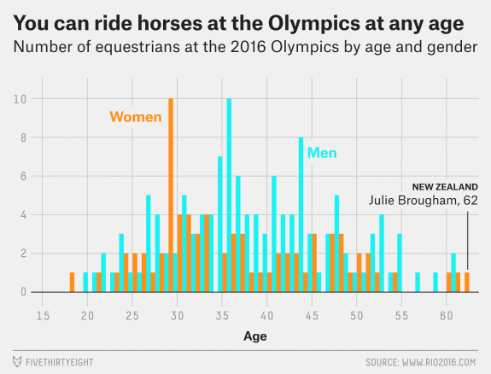
Horse Riders by Age and Gender ✔
Source: FiveThirtyEight
Histograms are relatively rare in non-scientific visuals
Shows the two distributions clearly
Conveys the message
The distributions are nearly identical
Uses labels for outliers

Slide 23
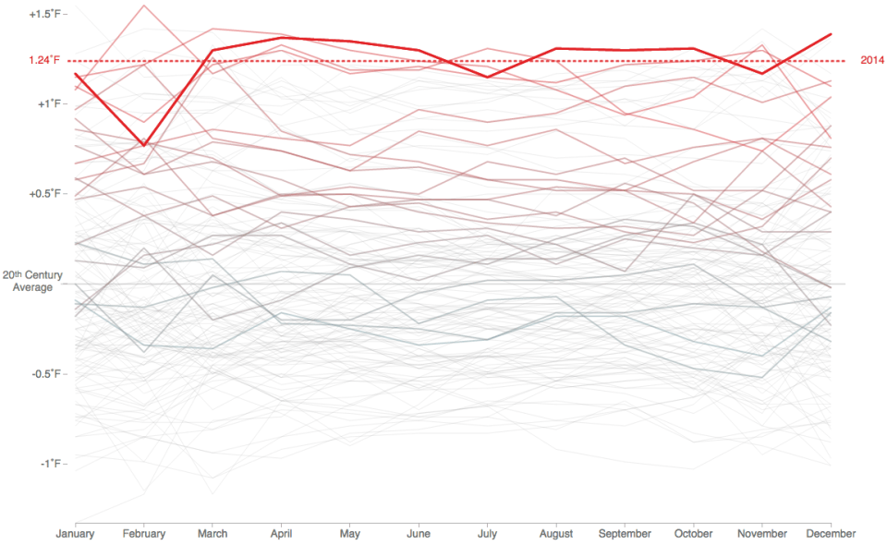
2014: The Hottest Year on Record ✔
Source: FlowingData
Presents temporal data in a classic way
Uses color to show rising temperature
Uses a thicker line to make it stand out in an otherwise very busy line plot

Slide 24
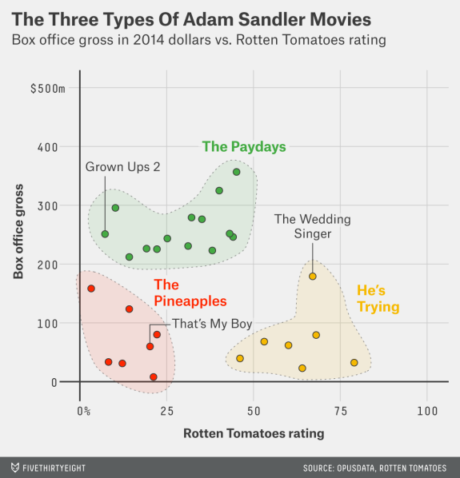
Types of Adam Sandler Movies ✔
Source: FiveThirtyEight
Presents a scatterplot of rating and profits
Shows and labels clusters clearly
Uses different colors
Conveys a clear message

Slide 25
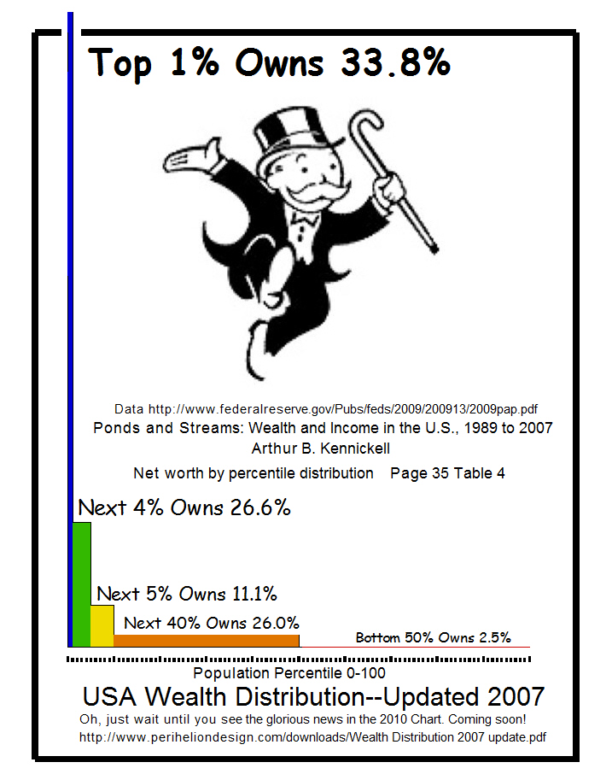
USA Wealth Distribution ✘
Source: WTFViz via Gizmodo
Highly skewed and disproportional elements
It wants to convey the message of disproportionality but there are better ways (e. g. "cutting" the y-axis and displaying y-axis labels)
Comic Sans(?!), useless image and useless text right in the middle of the chart

Slide 26
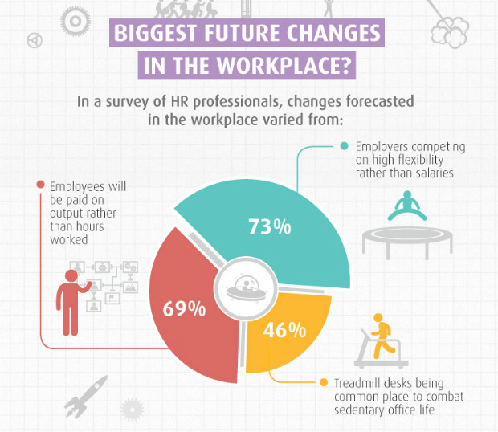
Too Much Pie ✘
Source: WTFViz via DesignRoast
The parts of the pie add up to 188%
They're meant to be viewed on their own, e.g. there might be combinations of factors
A pie chart is highly not recommended in this case
Other than that, it shows good labels and a nice color scheme

Slide 27
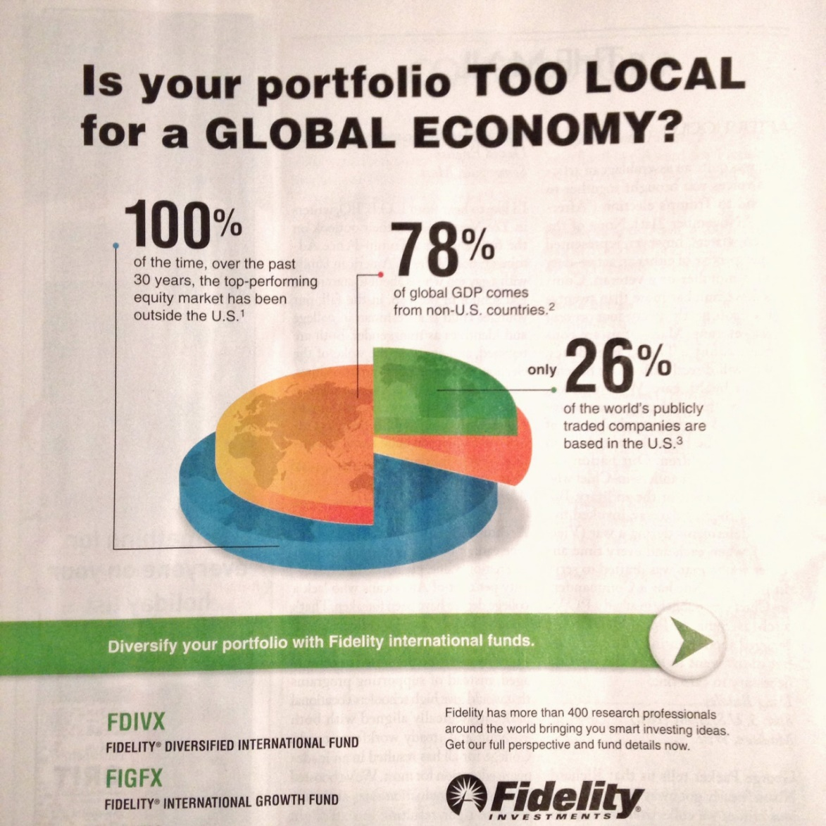
Too Much Pie, Part 2 ✘
Source: WTFViz (New Yorker)
Once again, the pie chart makes no sense
The values aren't related at all
Why is there a world map?

Slide 28
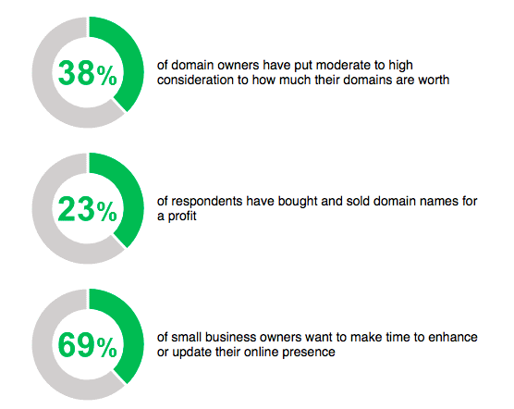
Too Much Pie, Part 3 ✘
Source: Email from GoDaddy, WTFViz
The numbers aren’t related to the color of the rings at all
Maybe just a programming mistake
Still, be careful and check your work

Slide 29
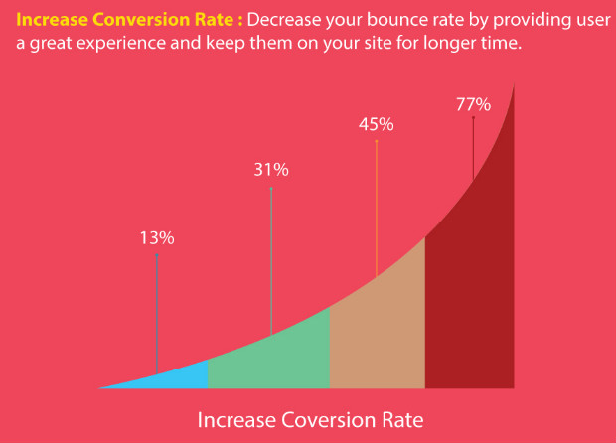
No Axes ✘
Source: WTFViz via DesignRoast
I don't know (and can't see) the real purpose
No axis labels and no numbers (the bottom label is not the x-axis)
Distracting background
Do you remember "Don't strain the reader"?

Slide 30
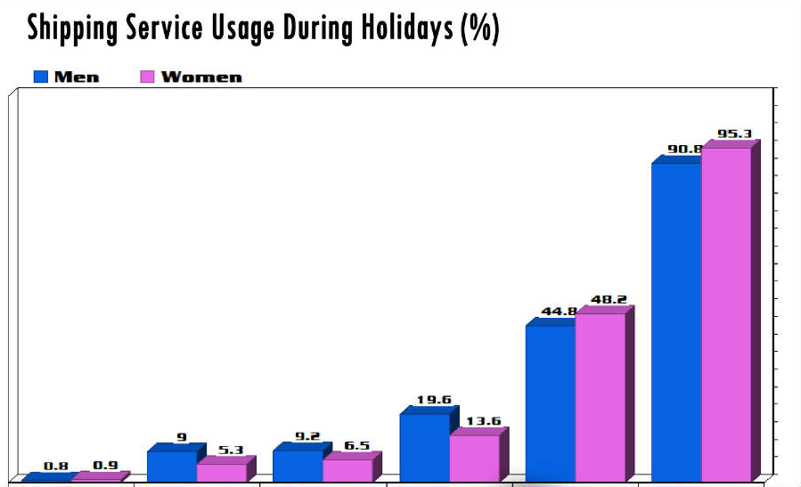
No Axes, Part 2 ✘
Source: WTFViz via DesignRoast
The categories are gone
The image is not trimmed, this is the entire chart
Are those different days, different products or something else?
Also, 3D doesn't give additional information
Also, the design is kind of lame

Slide 31
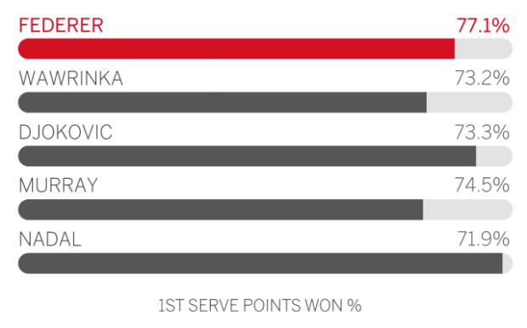
Wrong Scales ✘
Source: WTFViz via DesignRoast
How come 71,9% is
Further than 77,1%
Close to full (looks like 95-98%)

Slide 32
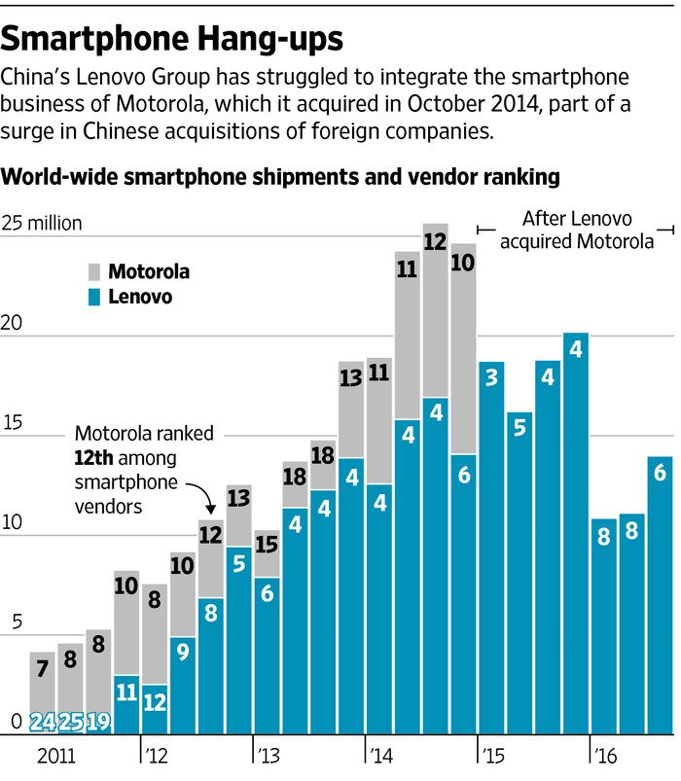
Double Scales that Make No Sense ✘
Source: WTFViz
The y-axis scales and the numbers on the bars represent different things
They're also on different scales (blue 11 is less than gray 10 but blue 4 seems very close to gray 18)
Impossible to read and understand without additional explanation

Slide 33
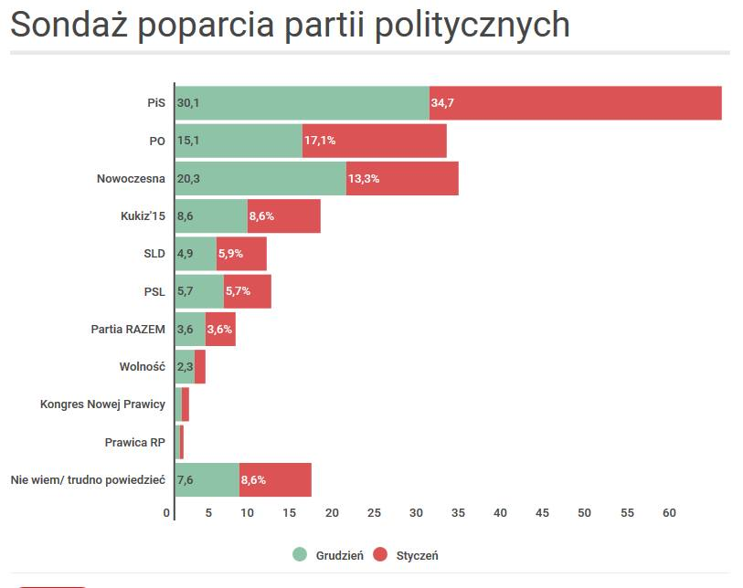
Wrong Data ✘
Source: WTFViz
The chart looks OK
Political party affirmation for December (blue) and January (red)
Why would one sum percentages like these? Makes no sense

Slide 34
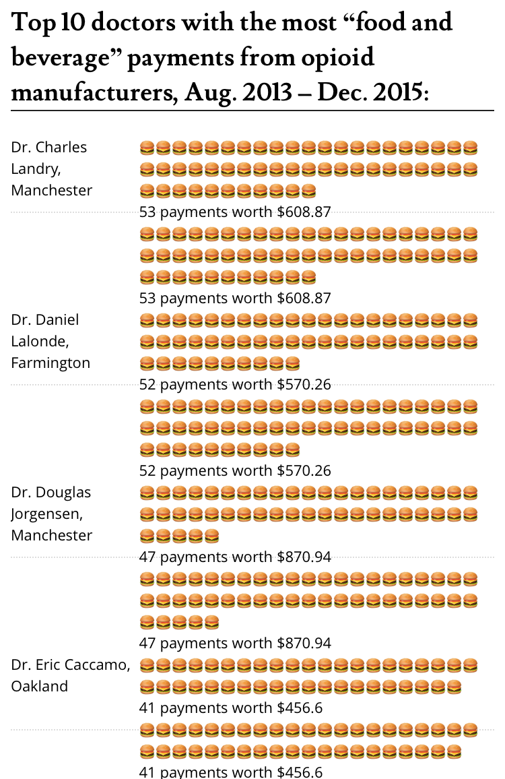
Wrong Data ✘
Source: WTFViz
Those burgers make data extremely difficult to compare
The numbers don't help very much

Slide 35
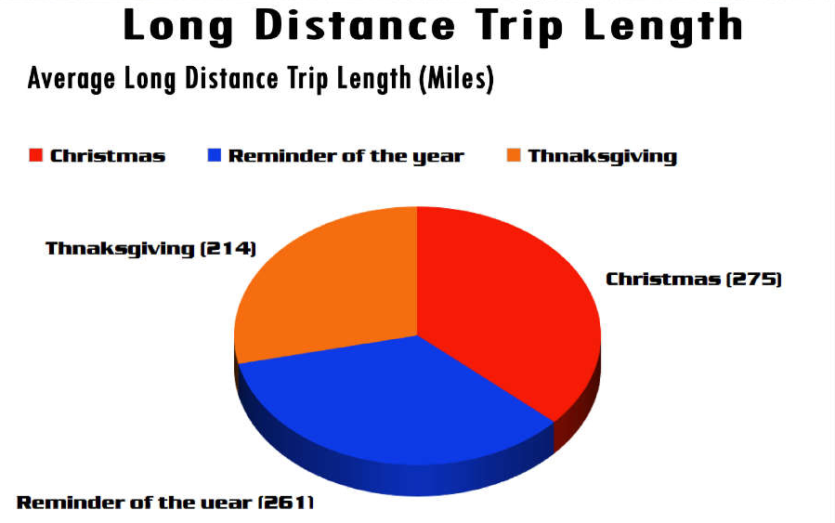
Wrong Information and Mistakes ✘
Source: WTFViz
Spelling errors
Also, unreadable font
The pie chart conveys no information at all
Better – use a bar chart

Slide 36
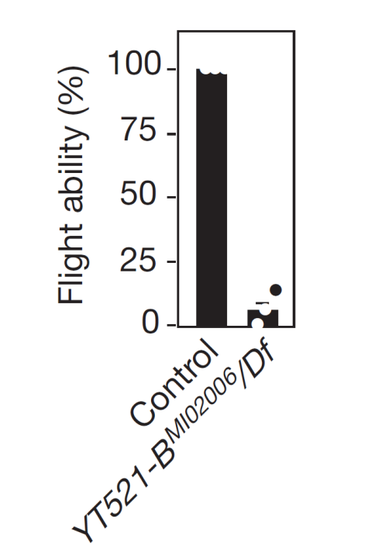
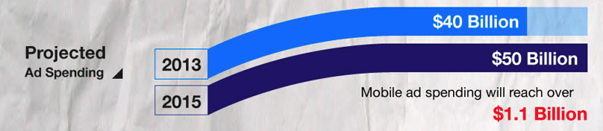
Bar Chart Mistakes ✘
Source: WTFViz
Original: Nature :(
Bubbles make the values extremely difficult to compare
Where does the right bar end?
Where does even the left bar end?
Below: Why are the bars warped?

Slide 37
Customizing Plots
Making things beautiful

Slide 38
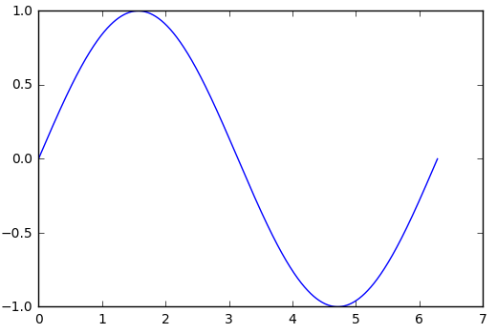
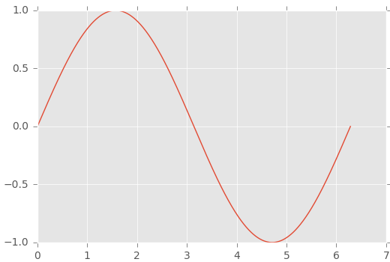
Applying Styles
Matplotlib has many default styles
Using a different style
Reverting to the default style
In Jupyter notebook, %matplotlib inline uses its own styles
Example: Draw a simple scatterplot, histogram and / or line chart in all different styles
print(plt.style.available)
plt.style.use("ggplot")
plt.style.use("default")

Slide 39
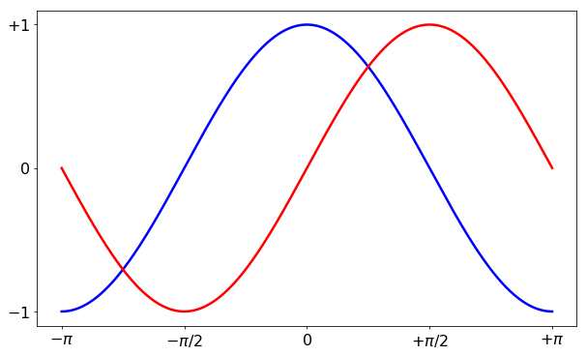
Customizing Plots
Every call to plt.hist(), plt.plot(), plt.boxplot(), etc., accepts many arguments
Colors, markers (type, size)
Axis limits and locations, axis labels
Data labels and additional text
Legend location and appearance
cos_x = ... # [-pi; pi]
sin_x = ...
plt.figure(figsize = (10, 6))
plt.plot(x, cos_x, color = "blue", linewidth = 2.5, linestyle = "-")
plt.plot(x, sin_x, color = "red", linewidth = 2.5, linestyle = "-")
# Tick marks and labels
plt.xticks([-np.pi, -np.pi / 2, 0, np.pi / 2, np.pi],
[r"$-\pi$", r"$-\pi/2$", r"$0$", r"$+\pi/2$", r"$+\pi$"])
plt.yticks([-1, 0, 1], [r"$-1$", r"$0$", r"$+1$"])
for label in ax.get_xticklabels() + ax.get_yticklabels():
label.set_fontsize(16)
label.set_bbox({facecolor: "white", edgecolor: "None", alpha: 0.65})

Slide 40
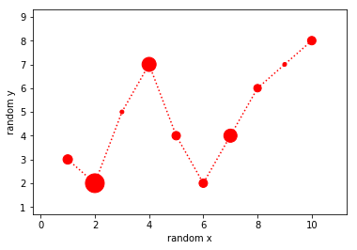
Example: Create a Customized Plot
Create a plot similar to the picture using the given data
This is to show that marker colors, sizes and types can be given as arrays – the elements are applied sequentially
x = [1, 2, 3, 4, 5, 6, 7, 8, 9, 10]
y = [3, 2, 5, 7, 4, 2, 4, 6, 7, 8]
y_radius = [10, 20, 4, 15, 9, 9, 14, 8, 4, 9]
# Note that s (for size) represents the area, not radius
plt.scatter(x, y, s = np.array(y_radius) ** 2, color = "red")
plt.plot(x, y, linestyle = "dotted", color = "red")
plt.xlim(np.min(x) - 1.3, np.max(x) + 1.3)
plt.ylim(np.min(y) - 1.3, np.max(y) + 1.3)
plt.xlabel("random x")
plt.ylabel("random y")
plt.show()

Slide 41
* Lab: Playing with matplotlib
A very good part of matplotlib are the examples
See them here
Many examples of common use cases
Creating multiple plots
Different types of plots: violin plot, residual plot, heatmap, etc.
Usages of color, shaded area, markers, labels, etc.
Play with some of these examples to get a feel of what you can do with matplotlib
Customize some of the examples
Read the docs to see all parameters

Slide 42
Exploratory Data Analysis (EDA)
Making sense of our data

Slide 43
Exploratory Data Analysis
A process to see what the data can tell us
Not tied to formal data modelling or hypothesis testing
Many people have written about this
Most notably, John Tukey (1961)
Like data cleaning, relies heavily on the scientist's intuition
Objectives
Suggest hypotheses
Assess assumptions on which models will be based
Aid selection of features (feature engineering)
Provide a basis for further data collections

Slide 44
Analytic Graphs
Good for explaining the dataset visually
Show distributions, relations, comparisons and causality even in multivariate data
Principles of analytic (scientific) graphs
Show comparisons
Show causality
Correlation does not imply causation
Show multivariate data (many variables)
Integrate evidence from multiple sources
Describe and document evidence
"Content is king"
We have to have something interesting to report
These principles apply to EDA as well

Slide 45
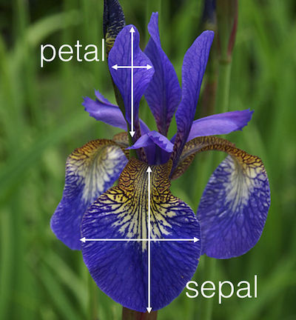
Exercise: Exploration of the Iris Dataset
One of the most famous datasets in data science
Sizes of petals and sepals (see picture) for three classes of iris flowers
Read, inspect and clean the dataset
Using the data cleaning approaches you already know
Can we predict classes from sizes?
Inspect the distributions
Plot histograms and boxplots, print stats
Try different plot settings
Compare the quantities – scatterplots
In some cases, a "brute force" method might be useful – compare everything against everything else
Plot a correlation matrix

Slide 46
Lab: Exploration of the Iris Dataset (2)
Usually, we first perform univariate analysis, then go on to find correlations
Plot the entire distribution first
Start to break down by factors (in this case – the iris types)
Create additional columns if needed (data transforms)
Apply grouping, averaging and summing over groups to get an idea of possible "clusters" in the data
Inspect and plot certain data ranges (using filtering)
Have fun with the data but don't forget the original question!
Next steps
After exploratory data analysis, we're usually able to form a hypothesis (a pair of hypotheses), model the data and check against the hypothesis
In other cases we can produce different visuals, graphics and dashboards to be used by others

Slide 47
* Lab: Exploration of the Iris Dataset (3)
We can also plot beautiful graphics using other packages (not matplotlib)
An example of one such package is seaborn
Contains utility functions for some commonly used plots
Based on matplotlib
Read the docs here
It shows how to plot different distributions on their own and together, and also includes a little tutorial on an algorithm called KDE (kernel density estimation)
It also has other tutorials (such as plotting linear correlations)
It produces good-looking graphics but can lack customizability in some cases
Other examples: bokeh, plot.ly, ggplot
And many more

Slide 48
Summary
Main concepts and rules
Creating simple plots
Real-life examples: good and bad
Customizing plots
Exploratory data analysis
Basic guidelines
EDA as part of the data science process

